Slide 1
Sarcasm as Contrast between a Positive Sentiment and Negative Situation
Ellen Riloff, Ashequl Qadir, Prafulla Surve, Lalindra De Silva, Nathan Gilbert, Ruihong Huang
(2013)

Slide 2
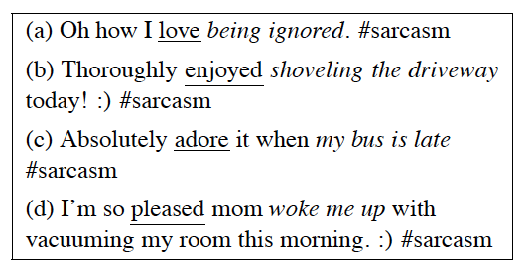
Introduction
Sarcasm can be manifested in many different ways, but recognizing sarcasm is important for natural language processing to avoid misinterpreting sarcastic statements as literal.
In the realm of Twitter, we observed that many sarcastic tweets have a common structure that creates a positive/negative contrast between a sentiment and a situation.
Specifically, sarcastic tweets often express a positive sentiment in reference to a negative activity or state.
For example

Slide 3
Introduction
The goal of our research is to identify sarcasm that arises from the contrast between a positive sentiment referring to a negative situation.
A key challenge is to automatically recognize the stereotypically(带有成见地) negative “situations”, which are activities and states that most people consider to be unenjoyable or undesirable.
Unenjoyable activities include going to the dentist, taking an exam, and having to work on holidays.
Undesirable states include being ignored, having no friends, and feeling sick.
People recognize these situations as being negative through cultural norms and stereotypes, so they are rarely accompanied by an explicit negative sentiment.
For example, “I feel sick” is universally understood to be a negative situation, even without an explicit expression of negative sentiment.

Slide 4
Contribution
We present a bootstrapping algorithm that automatically learns
phrases corresponding to positive sentiments
phrases corresponding to negative situations
using only the seed word “love” and a collection of sarcastic tweets as input

Slide 5
Overview of the Learning Process
Assumption
Many sarcastic tweets contain both a positive sentiment and a negative situation in close proximity, which is the source of the sarcasm.
Although sentiments and situations can be expressed in numerous ways, we focus on
positive sentiments
that are expressed as a verb phrase or as a predicative(表语) expression (predicate adjective or predicate nominal)名词性词
negative activities or states
that can be a complement to a verb phrase
Tweets are often informally written and ungrammatical
Try to recognize these syntactic structures heuristically(启发式) using only part-of-speech tags and proximity.

Slide 6
Overview of the Learning Process
Assumption
A positive sentiment verb phrase usually appears to the left of a negative situation phrase and in close proximity
[+ VERB PHRASE] [– SITUATION PHRASE]
Our structural assumption infers that “love” is probably followed by an expression that refers to a negative situation
“love” seems to be the most common positive sentiment term in sarcastic tweets.
Exploit the structural assumption in the opposite direction
Infer that the negative situation phrase is preceded by a positive sentiment
The bootstrapping process then iterates, alternately learning more positive sentiment phrases and more negative situation phrases.

Slide 7
Learning Negative Situation Phrases
Harvesting Candidate Phrases
Extract every 1-gram, 2-gram, and 3-gram that occurs immediately after of a positive sentiment phrase
For example
Tweet: I love waiting forever for the doctor #sarcasm
Candidates: waiting, waiting forever, waiting forever for
For negative situation phrases, our goal is to learn possible verb phrase (VP)
a unigram tagged as a verb (V)
7 POS-based bigram patterns
V+V, V+ADV, ADV+V, “to”+V, V+NOUN, V+PRO, V+ADJ
20 POS-based trigram patterns
designed to capture seven general types of verb phrases
verb and adverb mixtures, an infinitive VP that includes an adverb, a verb phrase followed by a noun phrase, a verb phrase followed by a prepositional phrase, a verb followed by an adjective phrase, or an infinitive VP followed by an adjective, noun, or pronoun.

Slide 8
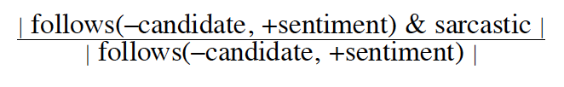
Learning Negative Situation Phrases
Scoring and Selecting Candidates
Score each negative situation candidate by estimating the probability that a tweet is sarcastic given that it contains the candidate phrase following a positive sentiment phrase:
Discard phrases that have a frequency < 3 in the tweet collection since they are too sparse.
Rank the candidate phrases based on this probability, using their frequency as a secondary key in case of ties.
The top 20 phrases with a probability 0.80 are added to the negative situation phrase list
Fewer than 20 phrases will be learned if < 20 phrases pass this threshold.
When we add a phrase to the negative situation list, we immediately remove all other candidates that are subsumed by the selected phrase.
The bootstrapping process stops when no more candidate phrases pass the probability threshold.

Slide 9
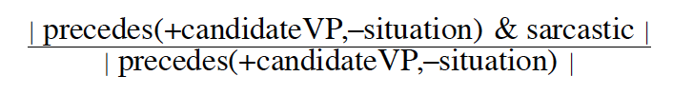
Learning Positive Verb Phrases
Collect phrases that potentially convey a positive sentiment by extracting n-grams that precede a negative situation phrase in a sarcastic tweet.
Filter the n-grams using POS tag patterns so that we only keep n-grams that have a desired syntactic structure.
contain at least one verb
consist only of verbs and (optionally) adverbs
Score each candidate sentiment verb phrase by estimating the probability that a tweet is sarcastic given that it contains the candidate phrase preceding a negative situation phrase:

Slide 10
Learning Positive Predicative Phrases
Use 24 copular verbs(连缀动词) from Wikipedia and their inflections.
Copulae: words used to link the subject of a sentence with a predicate
https://en.wikipedia.org/wiki/List_of_English_copulae
Extract positive sentiment candidates by extracting 1-grams, 2-grams, and 3-grams that
Appear immediately after a copular verb
And occur within 5 words of the negative situation phrase, on either side.
e.g., “It is just great that my iphone was stolen” or “My iphone was stolen. This is great.”

Slide 11

Learning Positive Predicative Phrases
Filter the n-grams using POS tag patterns
For predicate adjectives,
Retain ADJ and ADV+ADJ n-grams
Use a few heuristics to check that the adjective is not part of a noun phrase
e.g., Check that the following word is not a noun
For predicate nominals
Retain ADV+ADJ+N, DET+ADJ+N and ADJ+N n-grams
Discard all candidates with frequency < 3 as being too sparse
Score each remaining candidate by estimating the probability that a tweet is sarcastic given that it contains the predicative expression within 5 words of a negative situation phrase:

Slide 12

Learning Positive Phrases
In each bootstrapping iteration, add only
Top 5 positive verb phrases
Top 5 positive predicative expressions
Both types of sentiment phrases must pass a probability threshold of $≥$ 0.70

Slide 13
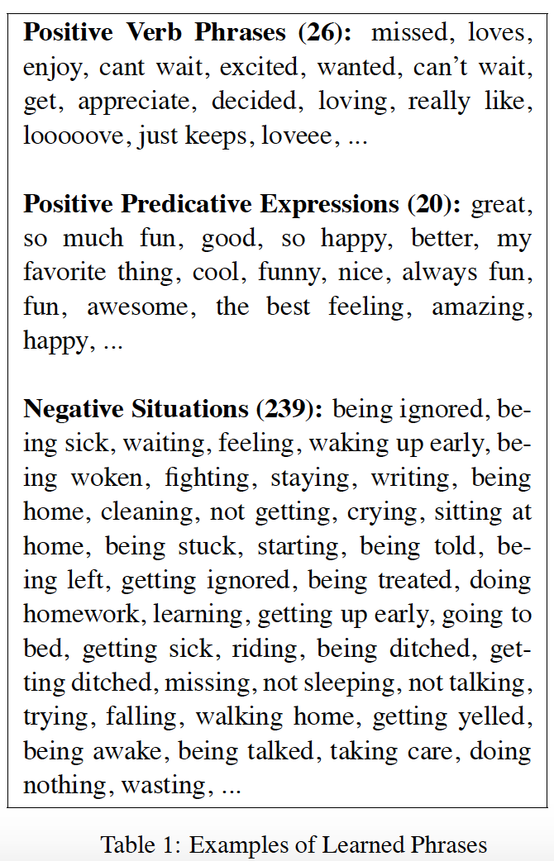
Learned Phrase Lists
In our experiments, we learned
26 positive sentiment verb phrases
20 predicative expressions
239 negative situation phrases.

Slide 14
Bootstrapping Data
Twitter
35,000 tweets that contain the hashtag #sarcasm or #sarcastic (20%)
140,000 additional tweets from Twitter’s random daily stream (80%)
Removed the tweets that contain a sarcasm hashtag, and considered the rest to be negative instances of sarcasm.
Applied CMU’s part-of-speech tagger designed for tweets (Owoputiet al., 2013) to this data set.

Slide 15
Evaluation - Data
Focus on identifying sarcasm that is self-contained in one tweet and does not depend on prior conversational context.
For example, a tweet such as “Yes, I meant that sarcastically.” should be labeled as not sarcastic because the sarcastic content was (presumably) in a previous tweet.
Collected 1,600 tweets with a sarcasm hashtag (#sarcasm or #vsarcastic), and 1,600 tweets without these sarcasm hashtags from Twitter’s random streaming API.
742 of the 3,200 tweets(23%) judged to be sarcastic
713 of the 1,600 tweets with sarcasm hashtags (45%) were judged to be sarcastic
29 of the 1,600 tweets (1.8%) in our data set that were obtained from the random stream and did not have a sarcasm hashtag, were judged to be sarcastic
We used
200 tweets as our Tuning Set
3000 tweets as our Test Set.
693 tweets were annotated as sarcastic

Slide 16
Baselines
Two baseline systems:
Support vector machine (SVM) classifiers (the RBF kernel)
One with just unigram features and one with both unigrams and bigrams.
binary values indicating the presence or absence of each n-gram in a tweet
The classifiers were evaluated using 10-fold cross-validation
The parameters were optimized for accuracy using unigram features and 10-fold cross-validation on our Tuning Set.

Slide 17
Baselines
Existing sentiment and subjectivity lexicons
Liu05
A positive and negative opinion lexicon from (Liu et al., 2005)
contains 2,007 positive sentiment words and 4,783 negative sentiment words.
MPQA05
part of the OpinionFinder system (Wilson et al., 2005a; Wilson et al., 2005b)
contains 2,718 subjective words with positive polarity and 4,910 subjective words with negative polarity.
AFINN11
designed for microblogs (Nielsen, 2011; Hansen et al., 2011)
contains 2,477 manually labeled words and phrases with integer values ranging from -5 (negativity) to 5 (positivity).

Slide 18
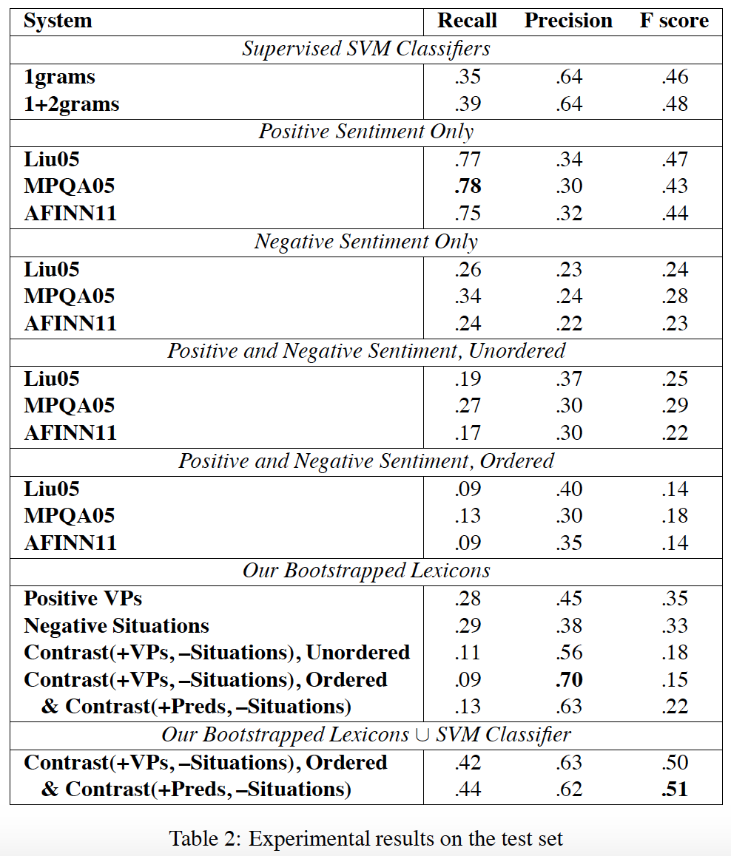
Experiment
Label a tweet as sarcastic if it contains any positive term in each resource
The Positive Sentiment Only section of Table 2 shows that all three sentiment lexicons achieved high recall (75-78%) but low precision (30-34%).

Slide 19
Experiment
Label a tweet as sarcastic if it contains any negative term from each resource
The Negative Sentiment Only section of Table 2 shows that this approach yields much lower recall and also lower precision of 22-24%, which is what would be expected of a random classifier since 23% of the tweets are sarcastic
These results suggest that explicit negative sentiments are not generally indicative of sarcasm.

Slide 20
Experiment
Label a tweet as sarcastic if it contains both a positive sentiment term and a negative sentiment term, in any order.
The Positive and Negative Sentiment, Unordered section of Table 2 shows that this approach yields low recall and low precision as well
relatively few sarcastic tweets contain both positive and negative sentiments,.

Slide 21
Experiment
Require the positive term must precede the negative term and near each other (no more than 5 words apart)
The Positive and Negative Sentiment, Ordered section of Table 2 shows that this ordering constraint further decreases recall and only slightly improves precision, if at all.
Our hypothesis is that when positive and negative sentiments are expressed in the same tweet, they are referring to different things.

Slide 22
Experiment
Evaluates the effectiveness of the positive sentiment and negative situation phrases learned by our bootstrapping algorithm.
Our Bootstrapped Lexicons section of Table 2

Slide 23
Experiment
Hybrid approach
a tweet is labeled as sarcastic if either the SVM classifier or the Contrast method identifies it as sarcastic

Slide 24
Analysis
Examined tweets that were incorrectly labeled as sarcastic by the Contrast method.
Some false hits come from situations that are frequently negative but not always negative
e.g., some people genuinely like waking up early
Most false hits were due to overly general negative situation phrases
e.g., I love working there
We believe that an important direction for future work will be to learn longer phrases that represent more specific situations.

Slide 25
Reference
Ellen Riloff, Ashequl Qadir, Prafulla Surve, Lalindra De Silva, Nathan Gilbert, and Ruihong Huang. 2013. Sarcasm as contrast between a positive sentiment and negative situation. In EMNLP, pages 704–714.

